Slide 1

Test Drive an Angular App
Using UI, Integration, and Unit Tests
Matthew Knowles
Software Craftsman at Greater Sum
www.GreaterSum.com
@MatthewYKnowles
Matthew.Knowles@GreaterSum.com

Slide 2
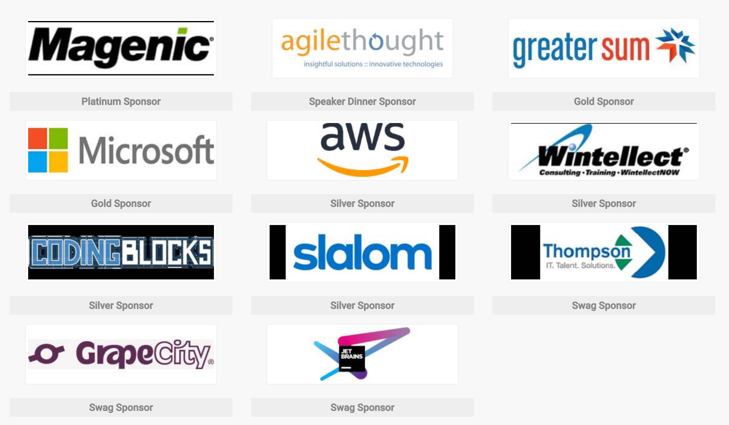
Atlanta Code Camp 2018

Slide 3
Tests
Notes:
We are going to talk a lot today about specific types of tests but lets first start zoomed out and ask why do we write tests? What reasons do y’all have for writing tests?

Slide 4
Why Write Tests?
Verify functionality
Defend against unexpected change
Executable documentation of the code
Notes:
These are generally the reasons I hear for writing tests.

Slide 5
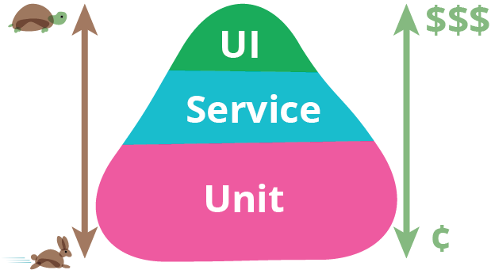
https://martinfowler.com/bliki/TestPyramid.html
Notes:
Today I am going to focus on three separate types of tests: UI, Integration (Service), and Unit Tests. The picture you see is of the automated testing pyramid. It describes the composition of tests that you would like to have make up your automated test suite. We will get more into what these different tests mean in a little bit but the important takeaway is that UI tests are extremely slow and expensive while unit tests are very quick and cheap. Money is a representation of time to write and time to maintain Some of you might be wondering why is it called a pyramid when it is clearly a triangle? Well that’s a great question… but googling for testing pyramid will give you a lot of great results on the types and ratios of automated tests you should write. My guess is they want the ratio to have some depth to it. Like your unit tests physically support your integration and UI tests.

Slide 6
UI Tests
Exercise your code in a live or live like environment
Verify that all components are connected correctly
Human Readable
Behavior Driven Development (Dev/Product/Test)
Acceptance Test
Signifies completion of a feature
Notes:
Behavior Driven Development is a methodology that encapsulates a lot but one of the core tenants is having a representative from product, dev, and test get together and come up with acceptance tests that flush out a feature. Today we are going to start writing our app with a failing acceptance test that when passing signifies that we have implemented the functionality that the product owner requested.

Slide 7
1st Acceptance Test – Product Prospective
We are creating a website for Atlanta Code Camp 2019 and we would like a way for potential speakers to submit their proposals.
Notes:
This is what the product side wants

Slide 8
1st Acceptance Test – Pseudo Code
Navigate to talk submission page
Fill in first name
Fill in last name
Fill in email
Fill in submission title
Fill in submission abstract
Submit talk
See submission was successful message

Slide 9
Protractor – built on Selenium with knowledge of Angular Components. Waits for async requests to resolve.
Notes:
Selenium tests can be written in a different language then your actual code base. At work we have a selenium test suite written in C# that tests our JavaScript FrontEnd but for this talk I went with Protractor which is built in to every Angular App made with the Angular CLI

Slide 10
Lets Create Our App and Write Our First Test
Tools I will be using
WebStorm from JetBrains (sponsor of Code Camp)
Angular CLI
NodeJS for package management
Premade CSS/HTML
Notes:
Live coding is an interesting way to see the code and tests form and the order they come in. Unfortunately I found that the same could not be said for CSS and HTML. So I will just be copying over premade CSS and HTML.

Slide 11
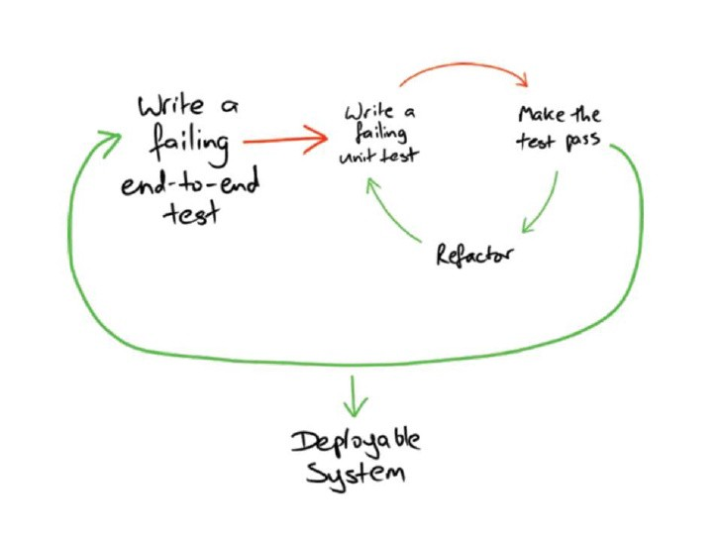
Double Loop TDD
https://medium.com/asos-techblog/atdd-acceptance-test-driven-development-at-asos-81577568e4f2
Notes:
The idea with double loop TDD or Acceptance Test Driven development is that we leave the Acceptance or UI test failing for awhile and do small Test Driven Development on smaller bits of logic to drive the code to pass the UI test

Slide 12
What is Test Driven Development (TDD) ?
Notes:
What do you understand about TDD? Has anyone used it?

Slide 13
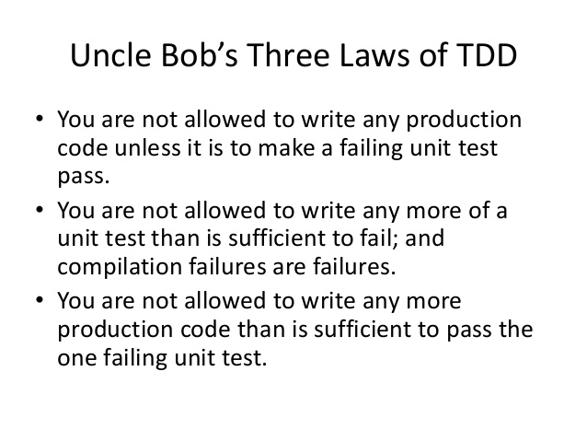
Notes:
These are Robert Martin’s (one of the main advocates for TDD) three laws of TDD. These laws create a cadence for first writing a small test, writing just enough code to pass that test and then writing the next failing test

Slide 14
First Integration or Service Test
Notes:
Testing integration of my code with framework. I would like to make sure that when I fill in all the form values on my component that I can correctly gather them up and create a submissions object and send it to my backend.

Slide 15
First Integration Test in Pseudo Code
Set firstName, lastName, email, submissionTitle, and Abstract in the input fields in my component.
Create a submission object to send to my backend
Send the submission to my backend
Mock what submits the submission to my backend so I am not actually sending anything
Notes:
Notice the language of my pseudo code is now in dev speak

Slide 16
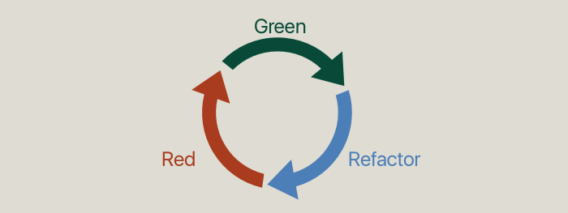
TDD Cycle
Notes:
Now that everything is green you can go back into your code and safely see if you want to change any of the names or the solution you choose to solve the problem initially.

Slide 17
2nd Acceptance Test – Product Prospective
We would not like any talks on blockchain next year
Notes:
This is what the product side wants

Slide 18
2nd Acceptance Test – Pseudo Code
Navigate to talk submission page
Fill in first name
Fill in last name
Fill in email
Fill in submission title using the words blockchain
Fill in submission abstract
Verify that a warning displays telling you no talks on blockchain

Slide 19
Conclusions

Slide 20
Whatever you would manually test try and automate
Notes:
Where you can start.
How will we know what we’ve made changes correctly?
How will we know that we haven’t broken anything?

Slide 21
Starting with a failing Acceptance Test focuses your code on value
Notes:
You only write the code that you need to dulfill th

Slide 22


Slide 23
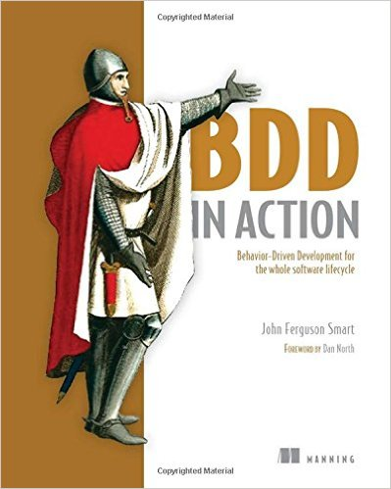


Slide 24
Questions?
@MatthewYKnowles
Matthew@GreaterSum.com

